Slide 1
MASTER SEMINAR PRESENTATION
Federated Discovery of
Unique Column Combinations (UCCs)
in Distributed Data
Student: Muhammad Raza Ali | Supervisor: Prof. Atakan Aral | University of Vienna · 17 June 2026

Slide 2
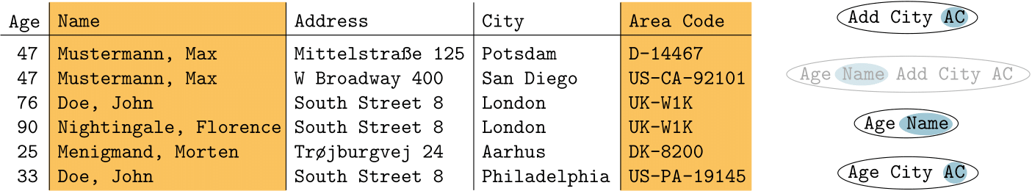
Unique Column Combination To Hitting sets
Figure by M. Schirneck.

Slide 3
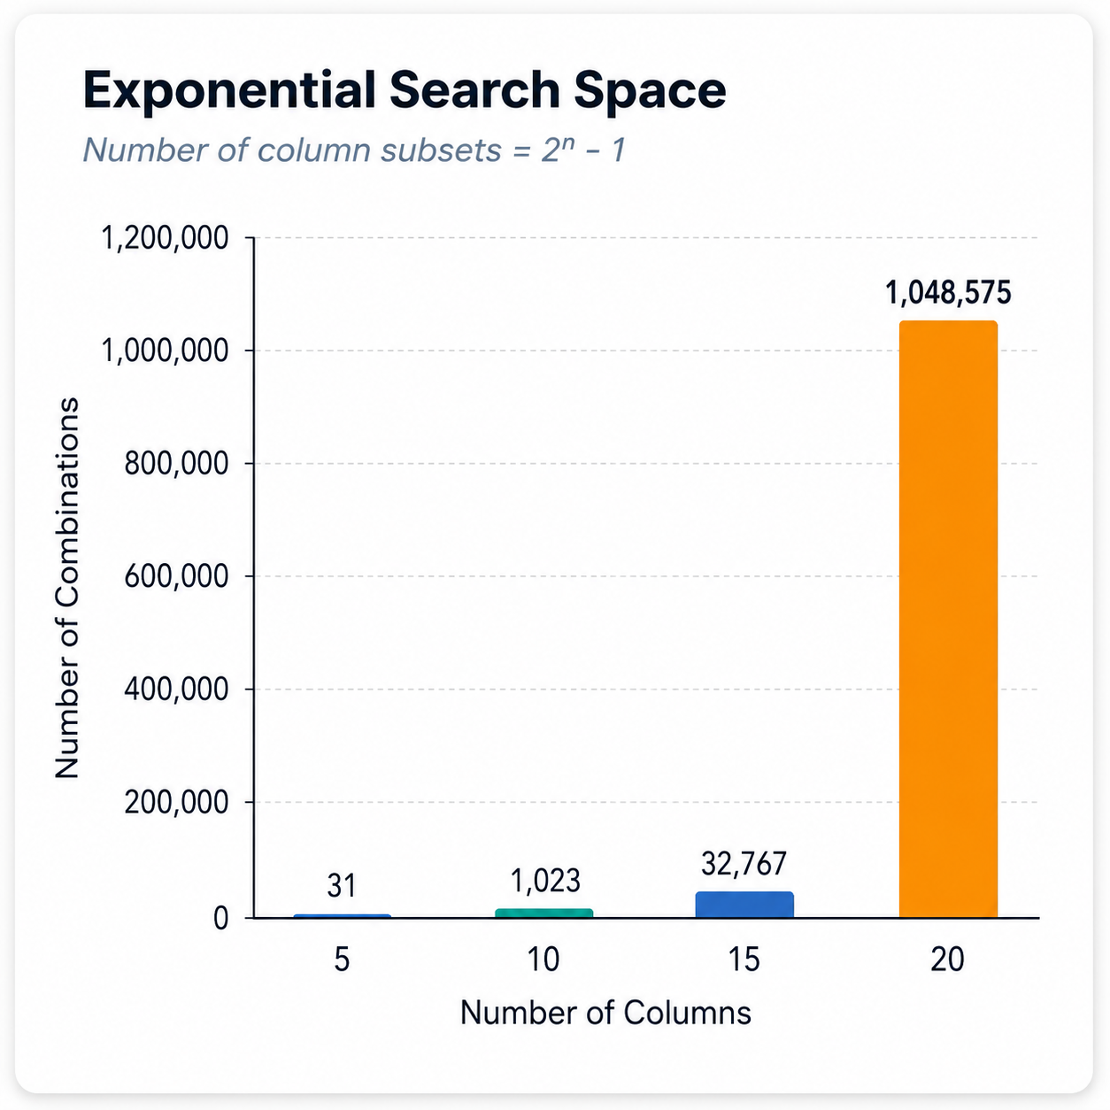




Why UCC Discovery Difficult
Exponential Space
Distributed notes
2ⁿ − 1 subsets to examine; brute force is infeasible even for moderate column counts.
Data across multiple nodes adds coordination, communication, and synchronisation cost.
Large Data Volume
Federated & Privacy Constraints
Millions of rows increase the cost of each uniqueness check substantially.
Raw data cannot always be shared between owners

Slide 4
Literature category: centralized UCC discovery
Representative approaches
GORDIAN
DUCC
HyUCC
FAIDA
Assume complete dataset is available centrally.
They use smart search strategies instead of checking every possible column combination

Slide 5
How works:
Generate possible column combinations,
Test whether that are unique,
Remove useless candidates using pruning,
Keep only minimal UCCs.
⚠ Limitation: All algorithms assume complete, centralised access to the dataset — incompatible with distributed or federated environments, Not enough for data split across independent nodes

Slide 6
Hitting set based UCC discovery
Instead of asking: which columns are unique?
They ask: which columns can separate all pairs of rows that look similar?
Imagine two rows are equal in some columns and different in others.
To make a column combination unique, it must contain at least one column that separates every conflicting pair of rows.
So UCC discovery becomes a minimal hitting set.
• Hitting Set Enumeration with Partial Information for UCC Discovery • Efficiently Enumerating Hitting Sets of Hypergraphs Arising in Data Profiling
Key Papers

Slide 7
Hitting set framework
Row-pair
conflicts
Difference
sets
Minimal hitting
sets
Minimal
UCCs
PLI: position list index- group rows with identical values per column.
Agree set: columns where two rows have the same value.
Difference set: columns where two rows have different values.
Hitting set: a set of columns that separates all conflicts.
Then they enumerate minimal hitting sets. These minimal hitting sets correspond to possible minimal UCCs.

Slide 8
Scalable and parallel UCC discovery
*PLI: position list index
“Scalable Discovery of unique Column Combinations” - introduces efficient parallelism for UCC enumeration
1
2
3
Work Partitioning
Memory-Aware Search
Pruning + Ordering
Distribute candidate column sets across multiple CPU cores for parallel evaluation.
Manage large PLI structures efficiently; avoid redundant recomputation across candidates
Prioritize promising candidates first; prune supersets of discovered UCCs early
Measured By:
Runtime
Speedup vs. # cores
Rows / Columns scalability
Memory consumption

Slide 9
Scalable and parallel UCC discovery
Where helps:
Large centralized datasets
Wide datasets with many candidate combinations
Multi-core execution on a single machine
Limitations:
Many approaches still assume central data access
Parallelism alone does not solve federated environment.

Slide 10
Critical Analysis: Gaps in Existing Work
01
Centralized Assumption
Most UCC algorithms require full access to all data in one location — impossible in federated settings.
04
Global Correctness Problem
A column combination unique locally may be non-unique globally — this must be addressed explicitly.
02
Limited Federated Support
Existing UCC methods do not address distributed data ownership or cross-nodes data sharing.
05
Parallelism + Federation Gap
Parallel and federated execution are typically treated independently, not as a combined system.
03
Communication Cost
Sending raw data or large intermediate structures between nodes is expensive and often prohibited.
Notes:
This is the most critical slide. Spend ~2 minutes here. Emphasize why the combination of federated + parallel has not been addressed.

Slide 11
Existing Work
This Thesis
Centralized: all data in one place
Federated: data stays distributed across nodes
Full data access required by algorithm
Local computation + central aggregation only
Parallelism applied within single machines
Parallelism across both nodes and within each node
Communication cost not explicitly modeled
Minimize communication as a first-class constraint
Federation and parallelism treated separately
Combined federated-parallel UCC discovery framework

Slide 12
Framework
Core Node
Core Node
Core Node
Client Node
True UCC
Server
Aggregation
Client Node
implement
Client Node
compute
Global minimal hitting set
Client Node
Global UCCs
.
.
.
.
.
n

Slide 13
Thank You
Questions?

Slide 15
Category | Main Idea | Strength | Limitation
Centralized UCC | Search & prune column lattice | Effective for single datasets | Assumes all data is central
Hitting Set Methods | Model UCCs as minimal hitting sets | Strong theoretical basis | Can still be computationally expensive
Parallel / Scalable | Parallelise candidate evaluation | Better runtime at large scale | Often still assumes shared / co-located data
Federated Profiling | Keep data distributed; share metadata | Data ownership & privacy respected | Global UCC correctness & comm. cost unsolved

